Slide 1



Happy Halloween
Take your name tag
Take some candies
Check-in

Slide 2
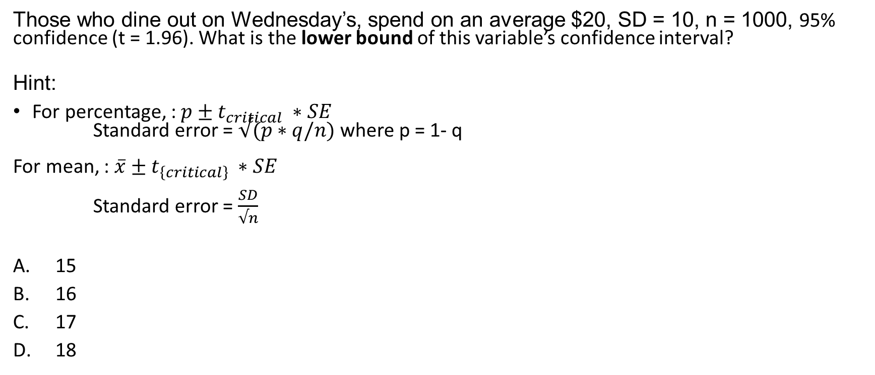
iClicker Question
Those who dine out on Wednesday’s, spend on an average $20, SD = 10, n = 1000, 95% confidence (t = 1.96). What is the lower bound of this variable’s confidence interval?
Hint:
For percentage, : $p±t_{critical} ∗SE$
Standard error = $√(p∗q/n)$ where p = 1- q
For mean, : $\overline{x}±t_{\left\{critical\right\}} ∗SE$
Standard error = $\frac{SD}{√n}$
15
16
17
18
Notes:
D

Slide 3
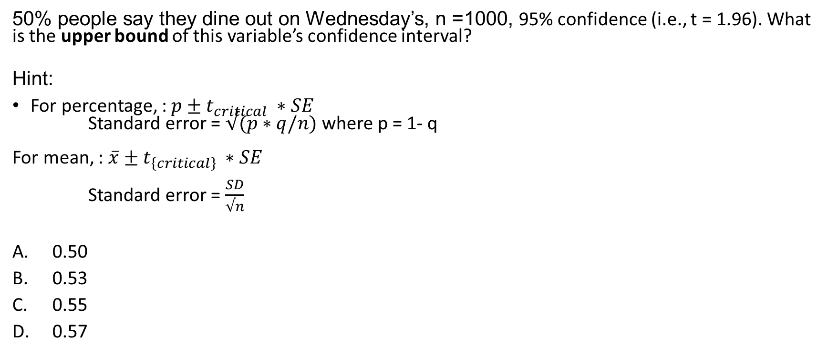
iClicker Question
50% people say they dine out on Wednesday’s, n =1000, 95% confidence (i.e., t = 1.96). What is the upper bound of this variable’s confidence interval?
Hint:
For percentage, : $p±t_{critical} ∗SE$
Standard error = $√(p∗q/n)$ where p = 1- q
For mean, : $\overline{x}±t_{\left\{critical\right\}} ∗SE$
Standard error = $\frac{SD}{√n}$
0.50
0.53
0.55
0.57
Notes:
0.52

Slide 4
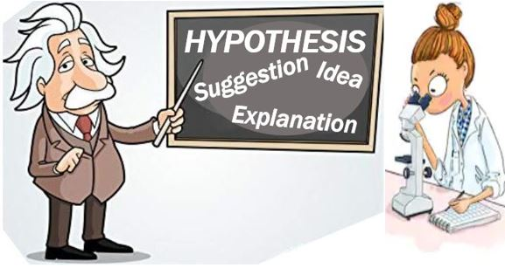
Hypothesis Statement
A hypothesis is an educated guess about something in the world around you. It should be testable, either by experiment or observation. For example:
A new medicine you think might work.
A way of teaching you think might be better.
“If I…(do this to an independent variable)….then (this will happen to the dependent variable).”
Notes:
SO the first thing today, we will cover hypothesis
Can somebody define what a hypothesis is?
Can you give an example of a hypothesis?
The main purpose of statistics is to test a hypothesis.
More examples: A possible location of new species.
A fairer way to administer standardized tests.
When we propose a hypothesis, it’s customary to write a statement. Your statement will look like this:
“If I…(do this to an independent variable)….then (this will happen to the dependent variable).”

Slide 5
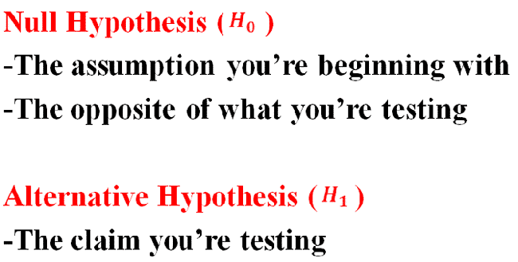
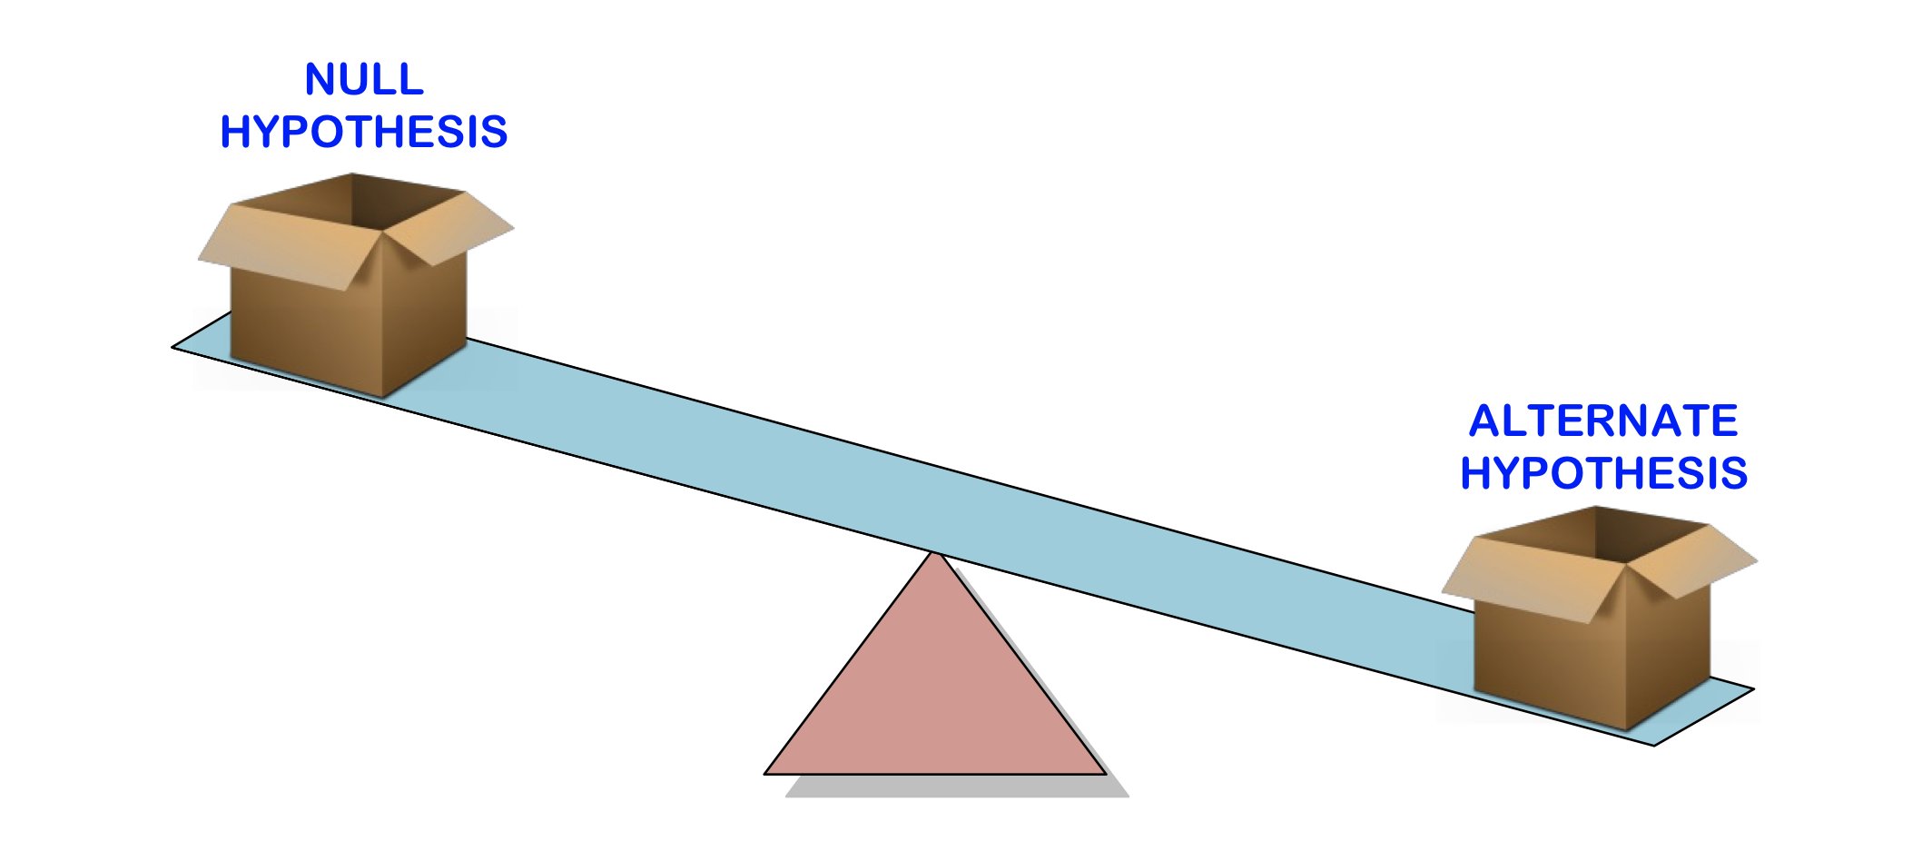
Hypothesis Testing
Hypothesis testing is a way for you to test whether your results are valid by calculating the odds (probability) that your results have happened by chance.
Steps for evidence-based science:
State your null hypothesis and alternative hypothesis,
Choose what kind of test you need to perform,
Either support or reject the null hypothesis.
Notes:
After having your hypothesis, you have to decide what type of hypothesis test is appropriate to figure out if you statement is likely to be true
Formally, hypothesis testing is …
And the three steps for evidence-based science are …
A quick tip to think about null and alternative hypothesis is that alternative hypothesis is the claim you are trying to test
While null hypothesis is the opposite of what you are testing, or conventional wisdom.

Slide 6
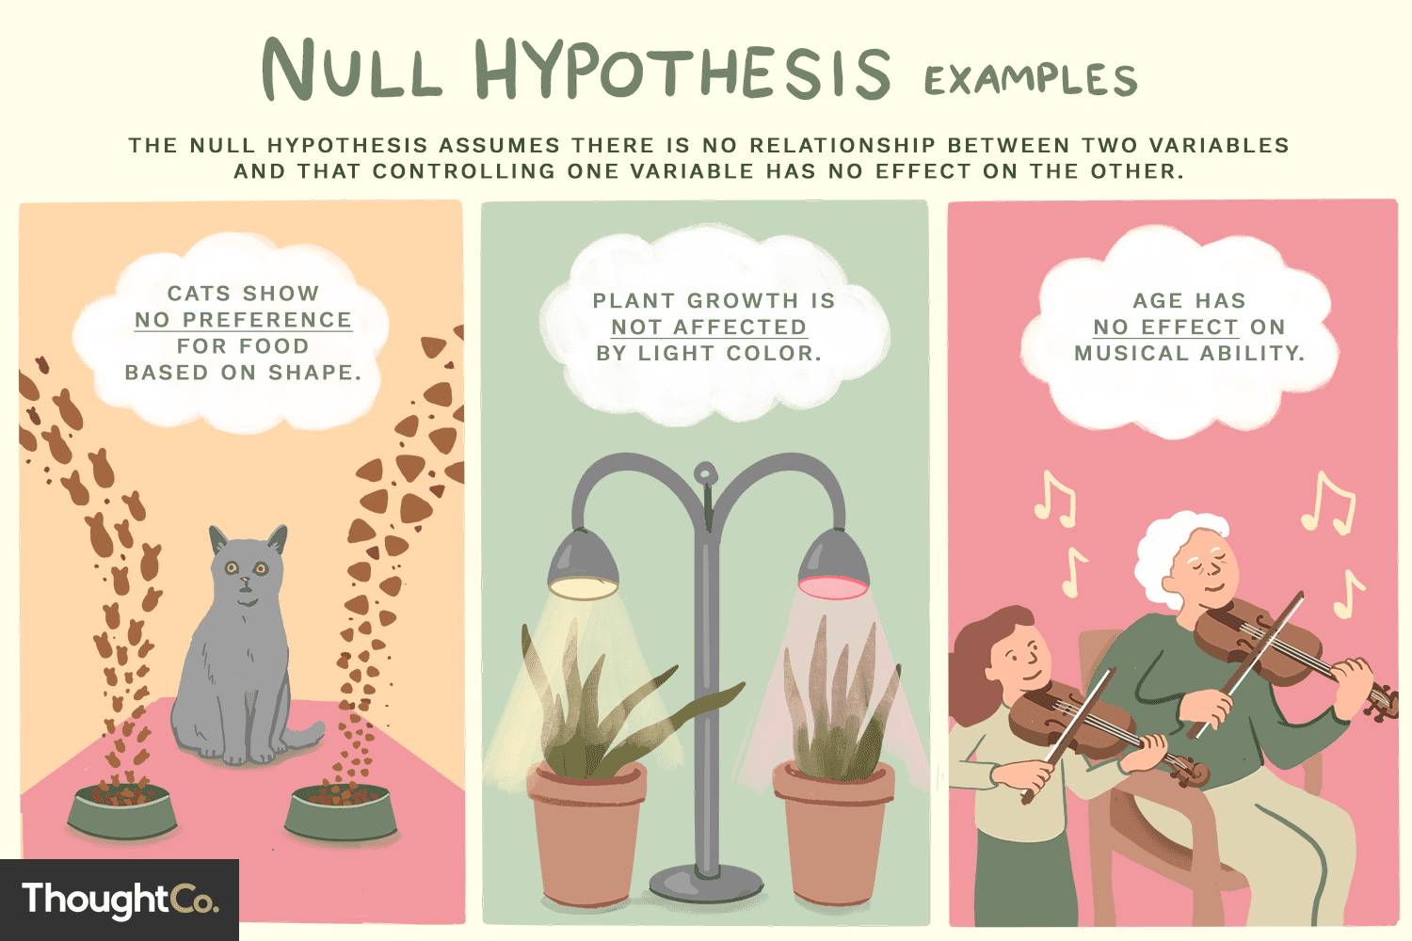
Null Hypothesis
The null hypothesis is usually the accepted fact. Simple examples of null hypotheses that are generally accepted as being true are:
H0: There is no difference between males and females in the satisfaction level regarding the rec center
H1/ HA: There are differences between males and females in the satisfaction level regarding the rec center
Notes:
Another way to think of null hypothesis is that it is usually the accepted fact.
An example of the null hypothesis that there is …
More examples include
As you can see that most null hypotheses contain the status quo.
Now we can go to the Rscript to visualize hypothesis testing
Go to the Rscript

Slide 7
Independent t-test
Hypothesis tests use samples to infer properties of entire population
T-test compare means
2 sample t-tests compare the means of 2 groups
Are two population means different?
Null and Alternative Hypotheses
Null: The two-group means are equal
Alternative: The two-group means are NOT equal
Statistically results: Reject the null hypothesis when the p-value < significance level
The formula for the independent t-test depends on the two samples’ variances
Equal variance
Unequal variance
For formal formulas: visit here
Notes:
The one sample t-test is rarely used with mean value, because we usually don’t have a good estimate or prior knowledge.
This t-test is equivalent to the coefficient t-test that we will cover later in regression. But we know we turn our attention to 2 independent samples t-test
Since all group have a difference research question between 1 categorial variable and 1 continuous variable, I’ll cover independent sample t-test
But we will not cover two-way chi-square test, which is for 2 categorical variables.
Other sessions do not cover either but I think this test is critical for you to understand and be able to present difference research questions.
Other sessions just do descriptive statistics that I do not think yield as much value as formal statistical tests.
And just a quick note for you that there is another type of t-test besides independent t-test and one sample t-test, which is paired t-test
Which is used in cases like you have before and after treatment, or twin study.
Start reading the slide

Slide 8
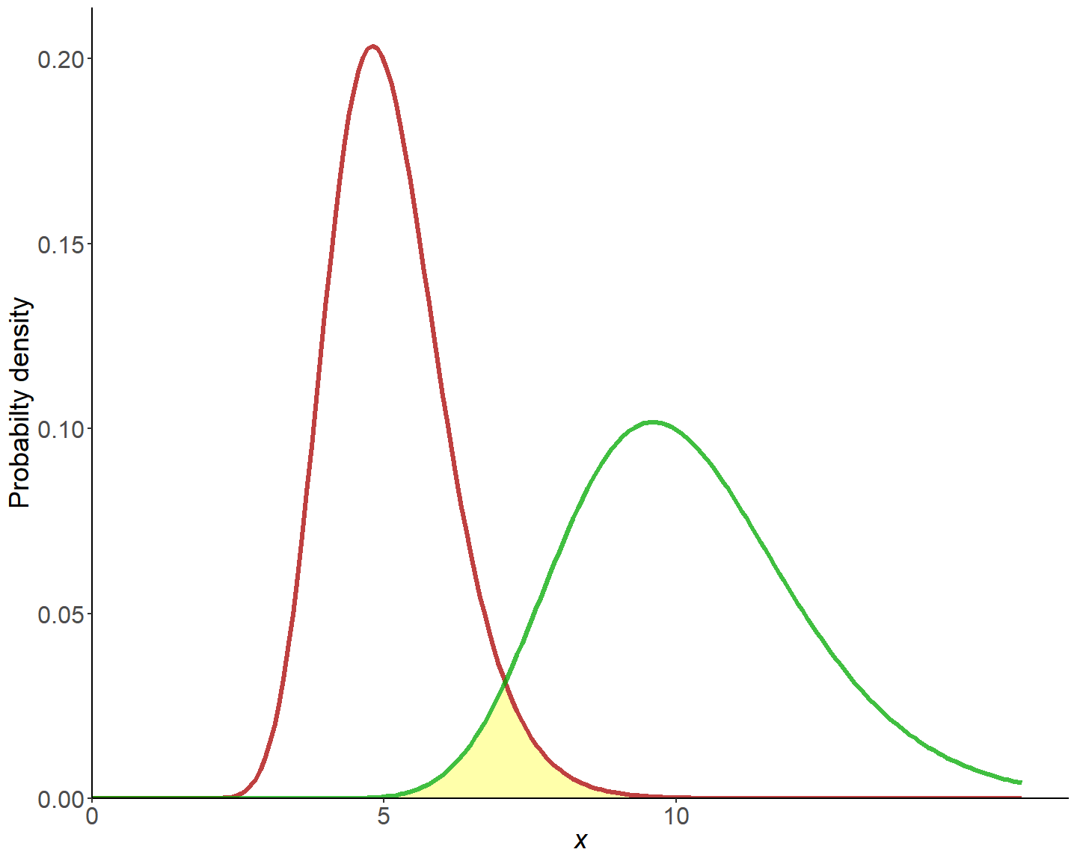

F-test for 2 Variances
H0: $σ_{x}^{2}=σ_{Y}^{2}$
H1: $σ_{x}^{2}≠σ_{Y}^{2}$
The shape of the 2 distributions can affect the mean hypothesis testing.
Notes:
Before we get to the t-test, we have to know whether the two samples’ variances are equal. Hence, we can use the F-test for 2 variances to figure this out.
I do not expect you to memorize the formula, but at least know how to use the software to derive at your result.
I can give you an intuitive understanding here.

Slide 9
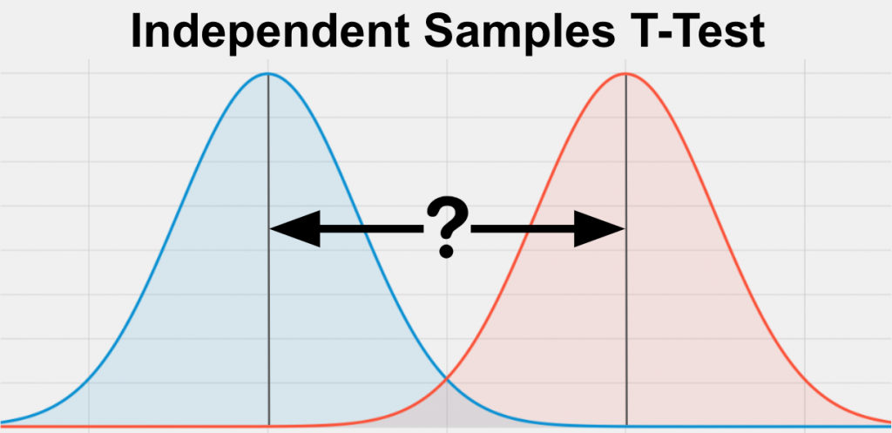

Two-sample independent t-test
H0: $μ_{x}=μ_{y}$
H1: $μ_{x}≠μ_{y}$
Based on whether you reject or accept the assumption that the two samples’ variances are equal, then you can select the appropriate test
Notes:
Go to Rscript first, then excel

Slide 10




Chapter 20: The Written Research Report
Notes:
Now, we will cover chapter 20 which I’ll say less cognitively demanding

Slide 11
Learning Objectives
Discuss three writing standards that a report should meet if it is to communicate effectively with readers
Outline the main elements that make up a standard research report
Explain the kind of info contained in the executive summary
Notes:
These are overall learning objectives

Slide 12
The Written Research Report
Research reports are evaluated based on one fundamental issue: How well do they communicate with the reader?
Near-perfect research can get lost in the clutter of a poorly written report
Notes:
Written report is all about how you communicate your result with your audience. Even if you run all kinds of fancy tests, if you cannot relay the results or be able to interpret and communicate them with your boss. Then, you can appear like you did nothing right?
A near-perfect …

Slide 13
The Paradox of Completeness
Completeness: The degree to which the report provides all the info readers need in langue they understand
A written report must be complete… without being too complete. The trick is to determine what really matters and what ought to be shifted to an appendix or left out entirely (caution).
Notes:
However, there is also the paradox of completeness
People who are involved in the analysis process usually want to be as complete as possible because they have done so much works that they want to show off how much work they have done. However, they can also run the risk of being too complete, that might stray their audience from the important message or takeaways.
On the other hand, people can also be deceiving that they can strategically omit stuffs, tests that did not fall into their prediction can be an example. In this case, you as co-workers or co-researchers need to step up and encourage completeness.
Strategic omission.

Slide 14
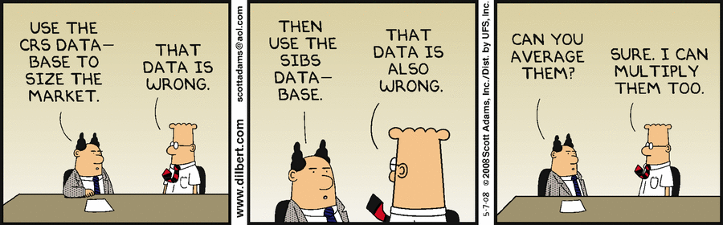
Accuracy
The degree to which the reasoning in the report is logical and the information correct
This Photo by Unknown Author is licensed under CC BY-SA
Notes:
You just don’t want to be deceiving or report incorrect information.
If you have two wrong datasets or data analyses, it doesn’t mean after averaging them you have a correct one.

Slide 15
Examples of Inaccuracy
Inaccuracy | Example
Simple Errors in Addition or Subtraction | “In the US, 14% of the population ahs an elementary school education or less, 51% has attended or graduated form high school, and 16 has attended college.”
Confusion between percentages and Percentage Points | “The company’s profits as a percentage of sales were 6% in 1997 and 8% in 20002. Therefore, they increased only 2% in five years.”
Inaccuracy Caused by Grammatical Errors | “The reduction in the government’s price supports for diary products has reduced farm income from $600 million to $800 million per year.”
Confused Terminology Resulting in Faulty Conclusions | “The Jones’ household annual income increased from $15,000 in 1976 to $45,000 in 2006, thereby tripling the family’s purchasing power.”
Notes:
These are examples of inaccuracy
Read them

Slide 16

Clarity
The degree to which the phrasing in the report is precise
Notes:
You also want clarity in your report. It just means you need to clearly communicate the results and the next step to your managers.

Slide 17

How to Achieve Clarity
Carefully organize your report
Write in short sentences and paragraphs
Write… rewrite… and rewrite again
Shorten the report until every word has purpose
Notes:
Clarity can be achieved by

Slide 18
Written Research Report Outline
Completeness must be balanced against Clarity

Slide 19
Written Research Report Outline
Exhibit 20.2 Written Research Report Outline
Title page
Table of contents
Executive summary
Introduction
Method
Results
Research Findings
Limitations
Conclusions and recommendations
Appendices
Copies of data collection forms
Data collection forms with univariate results
Codebook
Technical appendix (if necessary)
Exhibits not included in the body (if necessary)
Data file for archival storage
Bibliography
Notes:
Here is a formal written research report outline. You can review these slides later.
However, in this class I do not need you to write pages long of report.
If you can open an example of final report examples. We can go over my expectation together
Report Guidline: https://github.com/mikenguyen13/mar4050_F21/blob/master/project_assignment/written_report/Project%20Report%20Guideline.pdf
Example: https://github.com/mikenguyen13/mar4050_F21/blob/master/project_assignment/written_report/example1%20SlideDoc%20research%20report.pdf

Slide 20
Executive Summary
The executive summary is the most important part of the report
Think about what you would most want to communicate about he project if you only had 60 seconds to do so.
Introduction
Results
Conclusions
Recommendations

Slide 21
Introduction
The introduction sets up the project by providing background for the project and specifying the decision problem and research problem(s)

Slide 22
Method
This section is important – and difficult to handle well. You need to provide enough detail so that readers know how you conducted the research but not so much detail that they get lost and lose sight of the bigger story you are telling in the report.

Slide 23
Results
The results section should be organized to provide answers to the research problem(s) that motivated the project
Because no projects are perfect, be sure to include a limitation section. This often adds credibility to the overall project.
Tables and figures are encouraged IF they help communicate answers to research problems. Place them in the results section to illustrate the key findings.
All other exhibits should probably be placed in an appendix and referenced in the text as needed.

Slide 24
Conclusions and Recommendations
There should be a conclusion for each of the research problems that motivated the study
Researchers' recommendations about what to do next based on the research findings follow the conclusions

Slide 25
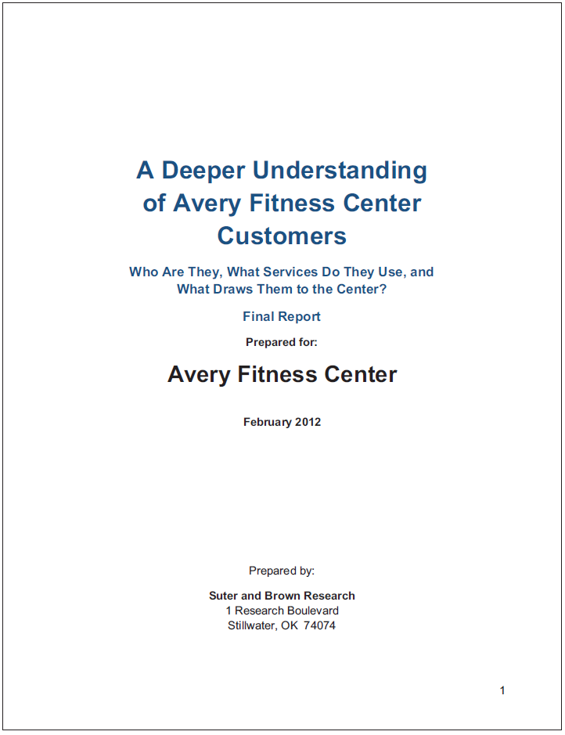
Appendices
The research report provides an archive of the project. Here are some things that should be included:
Copies of data collection forms
Univariate results and/or data tables (often placed on the data collection form)
Codebook
Technical appendix or any additional exhibits not included in results (if needed)
Data file
Bibliography

Slide 26
Data Analysis Plan Template Assignment 6
 |  | Data Analysis Plans
(1) | (2) | (3) | (4) | (5) and (6)
Research Question | Type of Research Question* | Questionnaire Question | Level of Measurement** | Descriptive statistics or Statistical Test
* descriptive or differences research question
** nominal, ordinal, interval, or ratio
Notes:
Go to assignment 6
https://umsystem.instructure.com/courses/41919/assignments/871304?module_item_id=2985137
Show template
Go to the difference quickly
I want to correct my statement in the last class that we did cover cross-tabulation. Hence, you should be able to present the table.
(open the data analysis plan example and regression descriptive statistics doc).

Slide 27
15-min Group Discussion
Sign up for presentation day (same link for the project meeting)
Each team will present 15 mins and 5 mins Q&A
Not all group members need to present (As long as your group finds optimal task allocation). Does not mean you can just skip class.
Discuss questions that allow you to use descriptive statistics (e.g., mean, prop, confidence interval, cross-tabulation) and independent t-test
Notes:
Do not skip class.

Slide 28
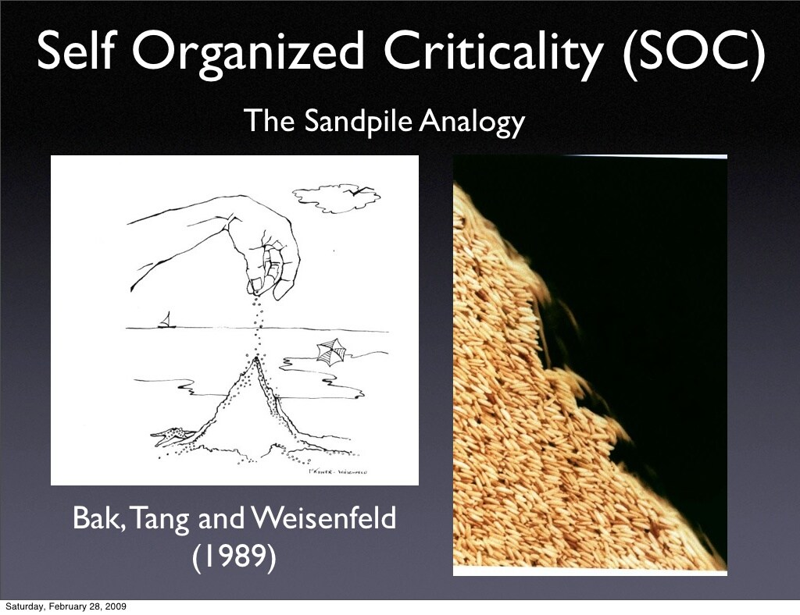
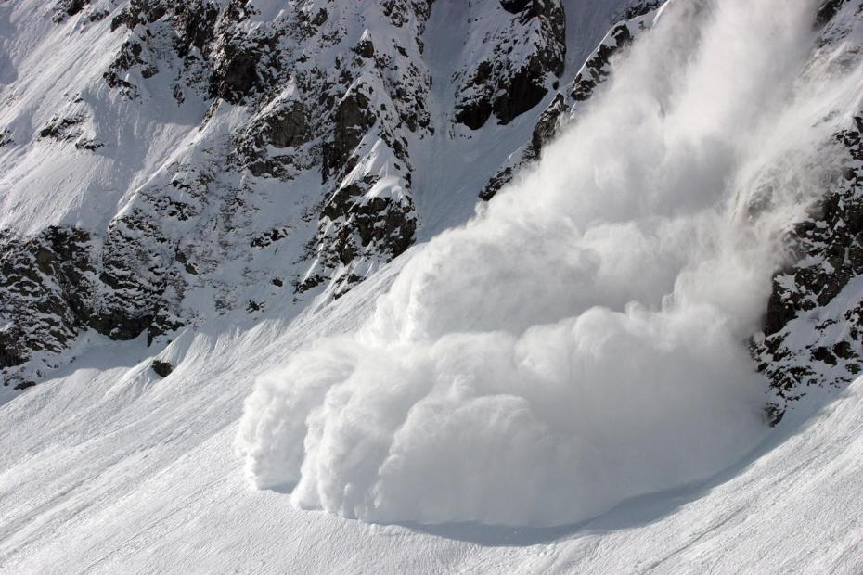
5-min Snippet – self-organized Criticality
Books
The Tipping Point
Why most things fail?
Ubiquity
Critical Mass
Terms:
Critical point/mass
Turning/Inflection/Tipping point
Notes:
Example: Critical mass is the point at which a growing company becomes self-sustaining and no longer needs additional investment to remain economically viable
A Turning Point is a critical time in your life where big decisions could lead to big change, both in work and in life
This model illustrates a phenomenon known as self-organized criticality. The world is filled with sand organized in columns. Falling sand stacks on top of the sand that is already there. Eventually a column will fall over because it gets too high, and the sand will spill into the surrounding area. This is called a cascade. When a falling column causes other columns to fall, the series of cascades is called an avalanche. The size of an avalanche is the number of cascades that occur from one grain of sand falling.
The graph illustrates the relationship between the logarithm of the size of cascades and the logarithm of the frequency of their occurrence. Per Bak and others pointed out that in this model this graph would eventually become a straight line. A straight line on a log-log graph is indicative of a power law, which means that the relationship between the x and y axes is of the form y = A^Bx. The fact that this power law occurs regardless of the starting circumstances and despite the fact that the process is random is what Per Bak called self-organized criticality.

